Slide 1






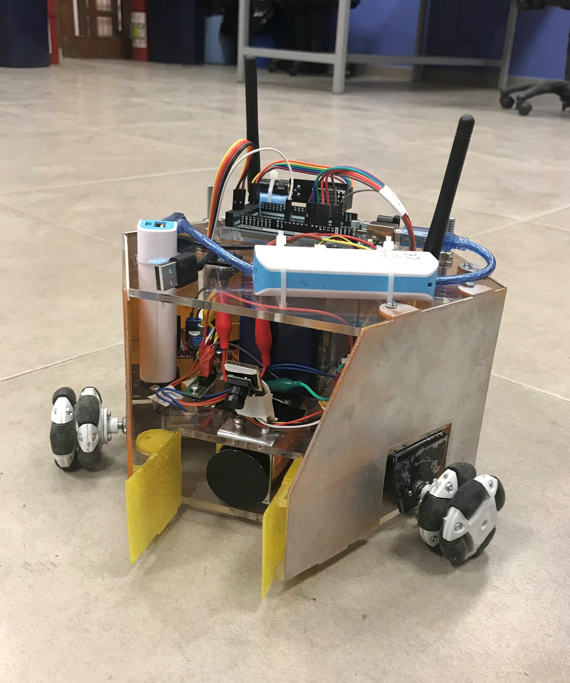
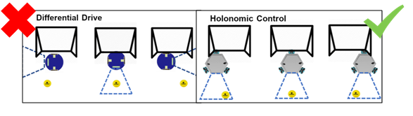
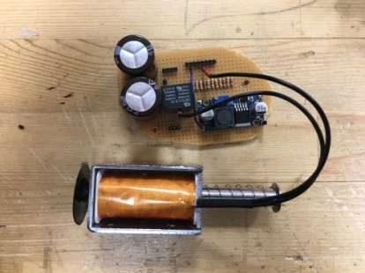
HELEN-V
Project Description:
“Design and construct one of the two teleoperated robots trying to shoot and score in opponent’s goal.”
Robots can hit, push or otherwise drive the ball but not grasp, scoop or otherwise carry it.
Successive contacts with the ball are allowed but the ball must be transferred to opponent’s half-field in no more than 20 seconds.
The player scoring 2 goals more than the opponent wins the game.
The game is started, upon command, with robots placed on their own goal lines and the goal at the center of the field.
SHAREHOLDERS:
Outstanding Features:
Holonomic Control
Powerful shooting
Hasan Özkara
Mert
Kayış
Kağan Özaslan
Caner Potur
Ercan Okatan
DELIVERABLES:
HELEN V
Eachine ROTG02 FPV Receiver
Command Transmitter Module
Artengo beach volley ball
BUDGET
Technical Specifications
Robot Part |  | Controller Part
Physical Specification |  | Physical Specification
Height | 21 cm | Size (height x length x width) | 50 x 26.5 x 17 cm
Diameter | 29 cm | Weight | 0.8 kg
Weight | 2.6 kg
Power Specifications |  | Power Specifications
Stand-by power | 4.8 W | Stand-by power | 1.56 W
Operating power | 49.5 W | Operating power | 1.56 W
Operating time | ~45 min | Operating time | ~5 hour
Item |  |  | Total Price ($)
Product | Pieces | Unit Price($) | Total Price($)
nrf24l01+ | 2 | 1.78 | 3.56
TS5828s | 1 | 7.70 | 7.70
Camera | 1 | 6.27 | 6.27
Video Receiver | 1 | 21.99 | 21.99
Arduino Uno | 1 | 3.21 | 3.21
Arduino Mega | 1 | 5.95 | 5.95
Joystick | 1 | 2.84 | 2.84
15dBi antenna | 1 | 2.24 | 2.24
12V Battery | 1 | 9.55 | 9.55
Powerbank | 2 | 4.75 | 9.50
DC motor | 3 | 8 | 24
L298n | 2 | 1.43 | 2.86
Omni wheel | 3 | 5.42 | 16.27
Solenoid | 1 | 13.5 | 13.5
Connection Equipment and body | 1 | 15 | 15
TOTAL | 21 pcs |  | 145
Subsystems
Video transfer sub-system 40CH 5.8G 600MW transmitter 150CH Dual Antenna Audio FPV Receiver
Command Transmission sub-system NRF24L01 2.4G Communication Module
Motor-drive sub-system Holonomic Control
Shooting sub-system Push-pull solenoid with 35V Capacitors
Test Results
Outdoor Range | 237 m
Indoor Range | 67.58 m
Robot Speed at Gear 1 | 10.35 cm/s
Robot Speed at Gear 2 | 30 cm/s
Average Speed of the Ball | 204.54 cm/s
Shooting Range | > 6 m

